Slide 1



JobBot
Next-Gen Job Search & ATS Platform
Complete visual redesign and UX architecture overhaul for login, dashboard, and administrative management.
"Smarter resumes. Faster applications. Zero hassle."

Slide 2


The JobBot Vision
Transforming the Job Search Flow
Job seekers spend hours adjusting resumes, hunting down postings, and repeating identical application forms across dozens of employer portals.
JobBot revolutionizes this process by creating a centralized, automated powerhouse. You upload your resume once, and JobBot extracts skills, matches high-affinity opportunities, and optimizes cover letters automatically.

Slide 3
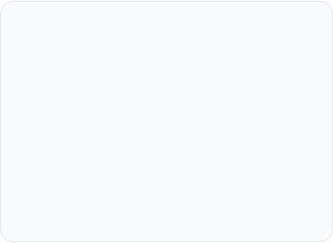
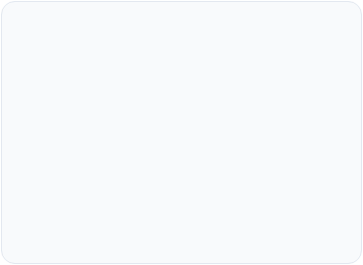
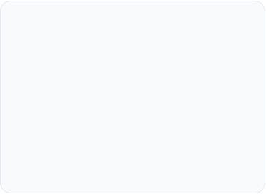



The End-to-End Workflow
1. Ingest & Parse
2. ATS Score & Tailor
3. Zero-Hassle Apply
Upload your resume in PDF or Word. Intelligent text extraction securely categorizes career history, technical proficiencies, and contact details without external leaks.
Postings from Adzuna and RemoteOK are scored against your profile in real-time. Customized cover letters and keyword alignments are generated in milliseconds.
Leveraging securely encrypted Gmail tokens, candidates can dispatch verified, tailored applications with one click and track statuses live on the console.

Slide 4
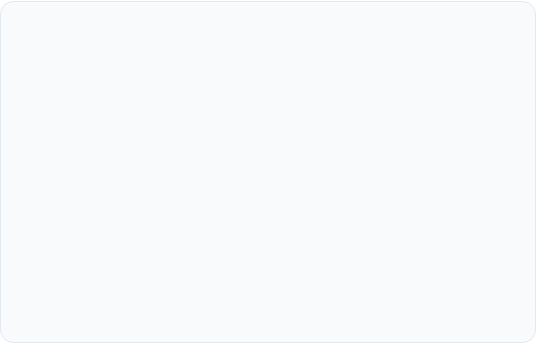
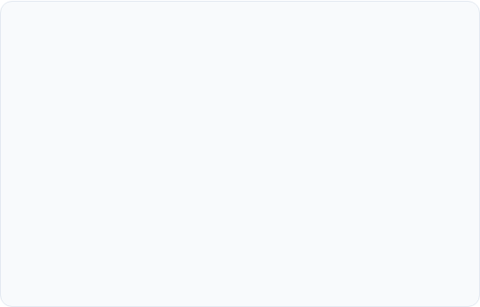

Brand Identity & Logo System
JobBot
Vibrant Yet Subtle Palette
Electric Indigo (#4f46e5): Dominant primary hue signifying intelligence and focus.
Visual Semantics
The lightning bolt emblem represents automated velocity, while the geometric frame symbolizes structured precision. The typography combines modern rounded geometry with high-contrast legibility for software professionals.
Cyan Blue (#0ea5e9): Dynamic accent communicating velocity and automation.
Emerald Green (#10b981): Status confirmation for high ATS matches and sent applications.
Slate Gray (#0f172a): Minimalist canvas keeping content scannable and distraction-free.

Slide 5


User Interface Architecture
A unified design system transitioning JobBot from basic web prototypes to an enterprise-grade, minimalist candidate portal.

Slide 6

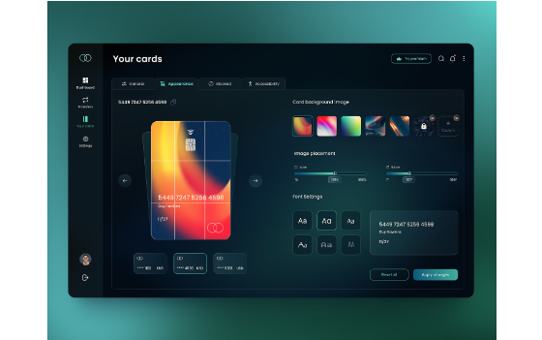
Redesigned Login & Auth
•
Elevated Brand Header: Centered JobBot logo with glowing badge and clear value proposition.
•
Focused Input Cards: Clean floating cards with subtle border focus states, removing clutter.
•
Admin Account Promotion: Automatic administrative privilege detection based on registered email.
•
Integrated Security Badging: Explicit indicators demonstrating encrypted password hashing and CSRF session security.

Slide 7
Dashboard Experience Overhaul
Persistent Header Navigation: Displays the JobBot logo, logged-in email badge, admin access portal, and quick logout control across every page.
Centralized Job Pool Hub: Shows scored vacancies from the shared database pool with instant match badges (e.g. 95% Match) and skill overlays.
Dynamic Resume Tailor Panel: Automatically crafts bespoke cover letters using your uploaded candidate background without external friction.
Encrypted Credentials Vault: Stores Gmail app passwords using server-side Fernet encryption, never exposing plaintext secrets.

Slide 8

Measurable Impact & Speed
Eliminating Application Fatigue
Traditional candidate workflows consume 35 to 45 minutes per targeted role, leading to high drop-off rates and keyword mismatch.
With JobBot's pre-scored pool and one-click tailor engine, tailored submissions take under 4 minutes. Job seekers submit higher quality applications with zero administrative hassle.
Faster Application Turnaround

Slide 9
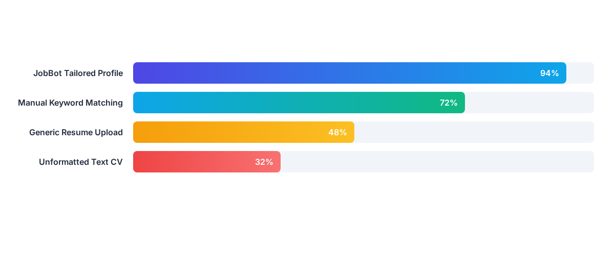
ATS Match Score Comparison
JobBot's automated keyword injection and ATS scoring module elevates applicant profile ranking above the top 90th percentile across standard automated screening filters.

Slide 10
Template Architecture Upgrade
Page / Module | Legacy Template | JobBot Redesign | User Experience Benefit
Header / Brand | Raw plain text | Global logo & navigation header | Instant recognition & consistent orientation
Login / Register | Basic unstyled HTML inputs | Minimalist cards with subtle glow | Modern onboarding with zero cognitive load
Dashboard UI | Linear text tables | Tiled job cards & match score badges | Scannable decision-making and 1-click actions
Admin Panel | Unformatted logs | Visual telemetry & pool refresh actions | Effortless monitoring of active candidates

Slide 11
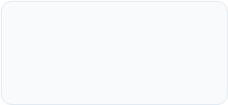

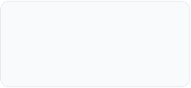

Production Rollout Roadmap
Step 2: Dashboard UI
Step 4: Render Deploy
Upgrade dashboard.html with match cards, ATS scores, and cover letter generator.
Push updates to GitHub repository; Render triggers zero-downtime deployment.
Step 1: Auth & Brand
Step 3: Admin Console
Integrate JobBot logo header and minimalist cards into login.html and signup.html.
Enhance admin.html with real-time status counters and pool refresh triggers.

Slide 12

JobBot
Ready for Launch
Deploy the updated templates and elevate your candidates' job search experience on Render.

Slide 13


Image Sources
https://media.istockphoto.com/id/2208002582/photo/concentrated-latin-business-woman-saleswoman-working-on-laptop-computer-reading-financial.jpg?s=612x612&w=0&k=20&c=2t0MjdLhyS5FFL87QJypaGgVakQ5pQM2htViQ-Sgz9w=
Source: www.istockphoto.com
https://miro.medium.com/v2/resize:fit:2000/1*-867UFIo3H3-rjsJCmQy3g.png
Source: medium.com

